Slide 1
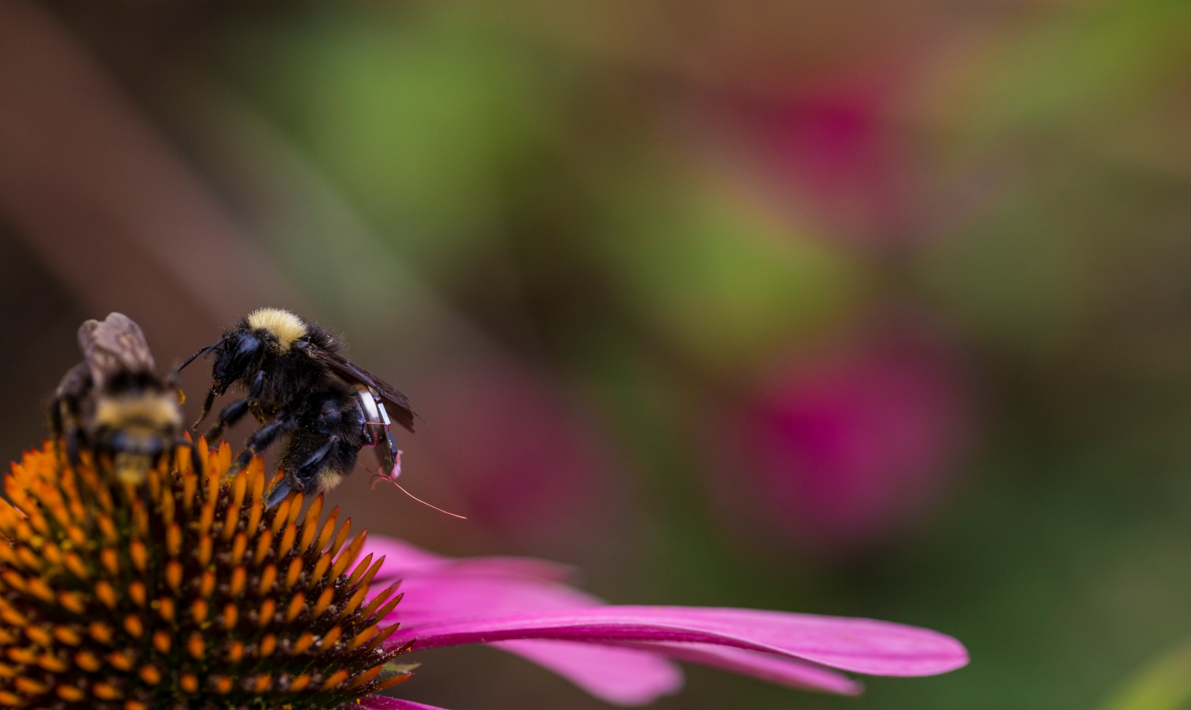
Living IoT: A Flying Wireless Platform on Live Insects
Vikram Iyer,
Rajalakshmi Nandakumar,
Anran Wang, Sawyer Fuller,
Shyam Gollakota

Slide 2
What if Internet of Things (IoT) devices could fly?

Slide 3
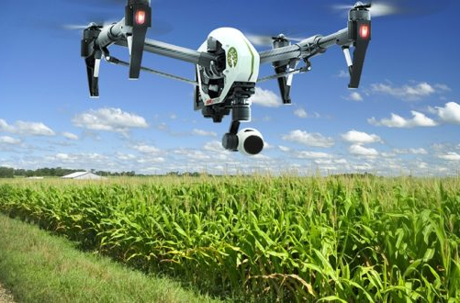
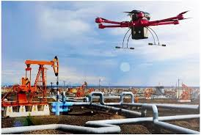
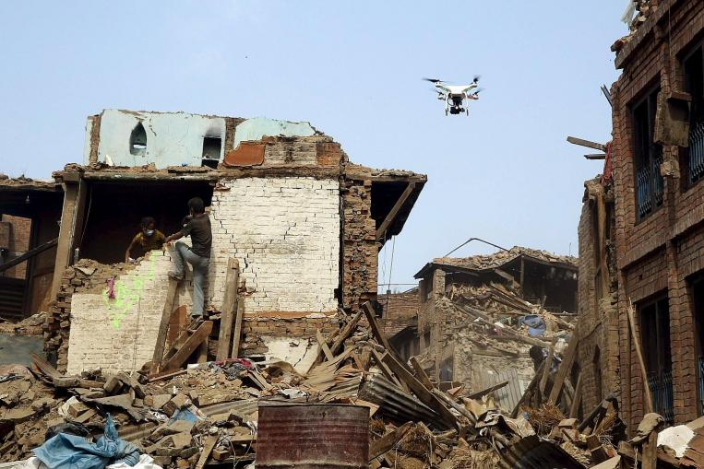
Drones as flying sensor platforms

Slide 4
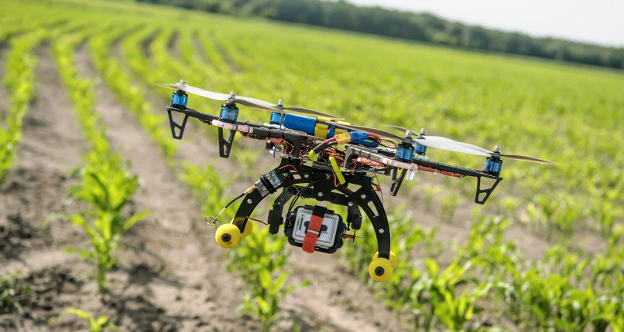
Drones consume lots of power
Need recharging every 10-20 min

Slide 5
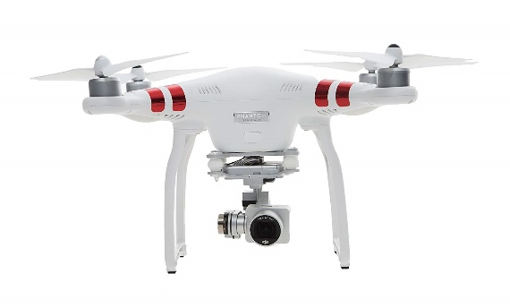
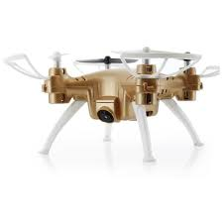
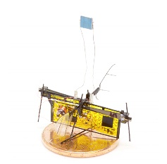
Drones consume lots of power
20
15
10
5
0
Battery life (min)
DJI Phantom 3
Skyeye-Nano
UW Robofly
0 10 20 30
Width (cm)
Fundamentally hard to get long battery life

Slide 6
Look to nature for solutions

Slide 7
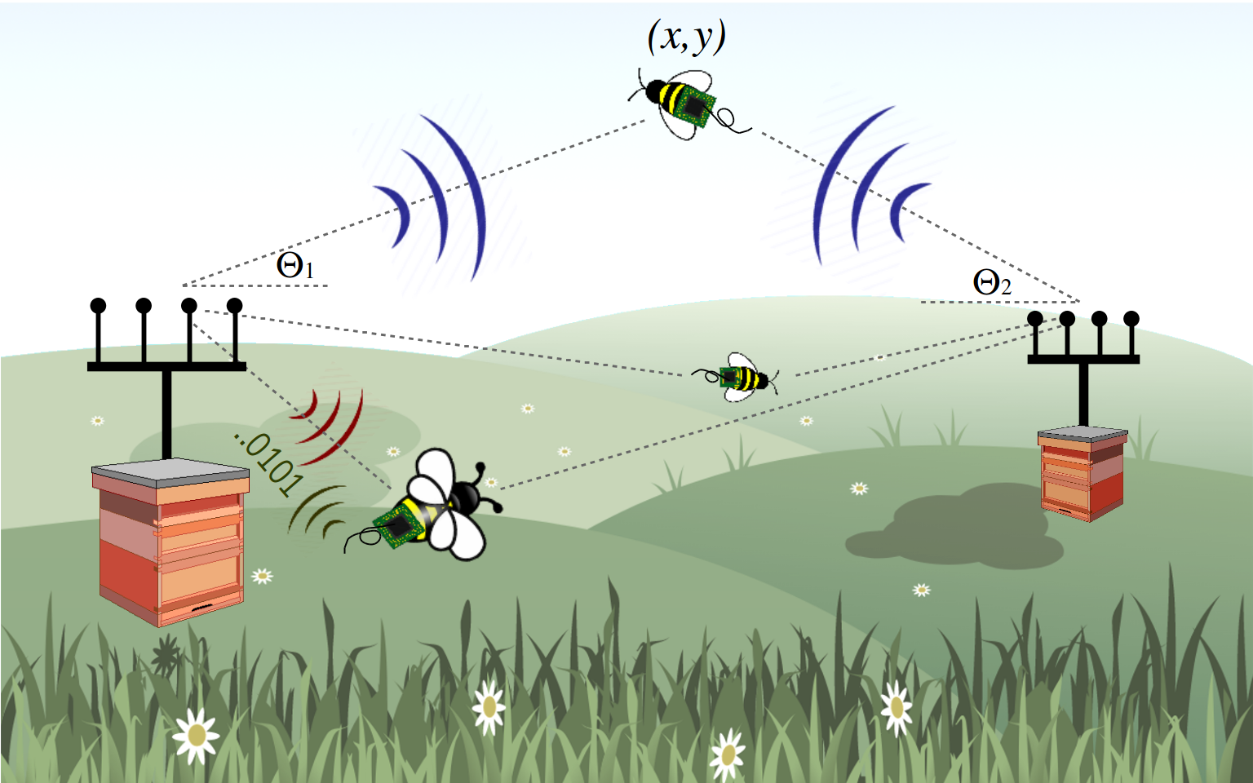
Idea: Use live insects to carry wireless sensors

Slide 8
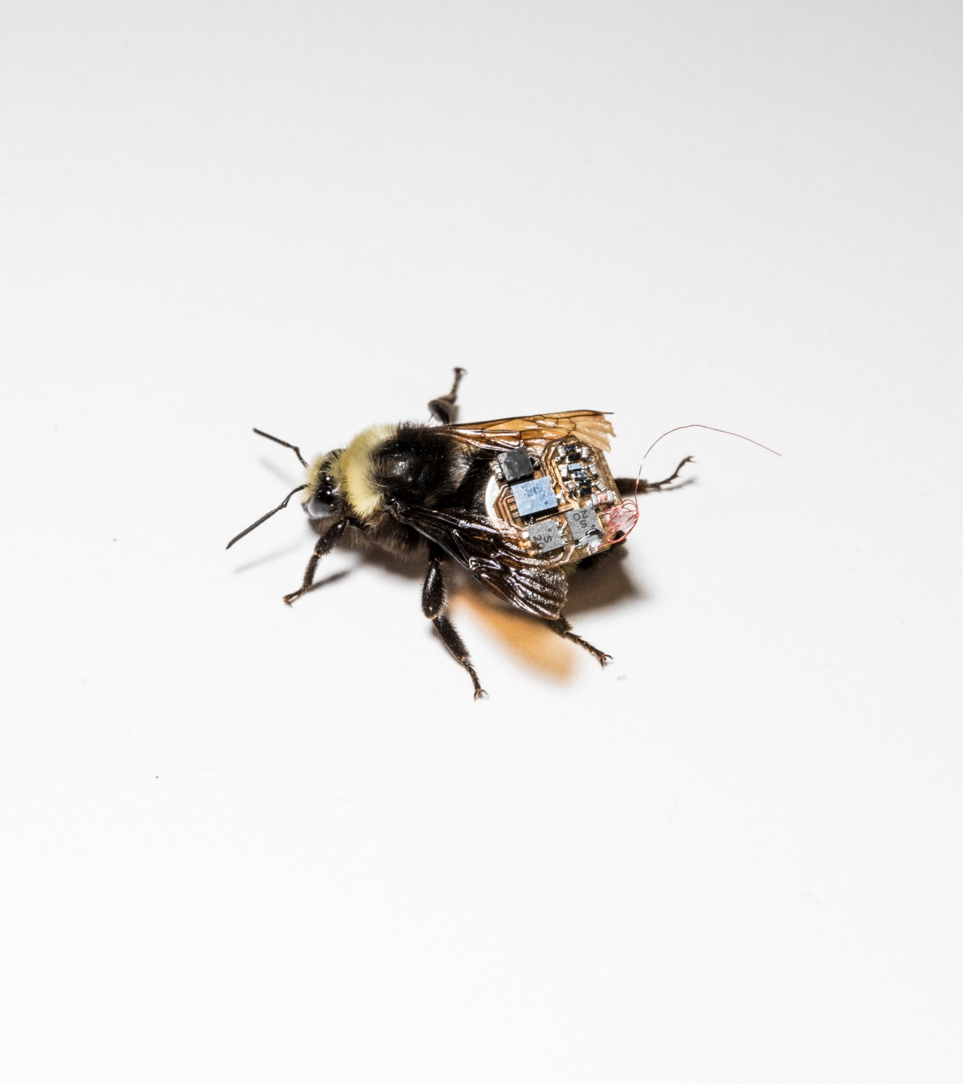
Bio-based solution
No need for mechanical propulsion
Bees are introduced on farms for pollination
Bees sense their environment

Slide 9
Live bumblebee carrying our sensors and electronics

Slide 10
Challenge 1: Small weight and low power
Size/Weight
Power
~100 mg = 70 mg battery + 30 mg electronics

Slide 11
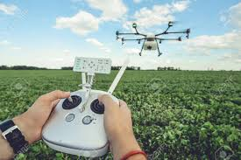
Challenge 2: Can’t control bee motion

Slide 12
Our Solutions
Building lightweight hardware
2D location tracking of bees

Slide 13
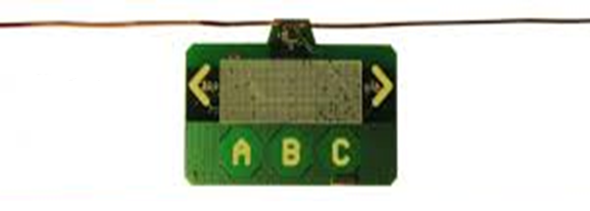
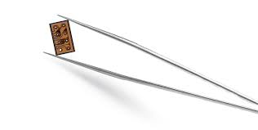
New problem: designing for small size and weight
Ambient backscatter
Custom ASIC
+ Lowest power and size
- Needs external components
- Long expensive process
- Not programmable
Freerider
Need light-weight programmable solution

Slide 14
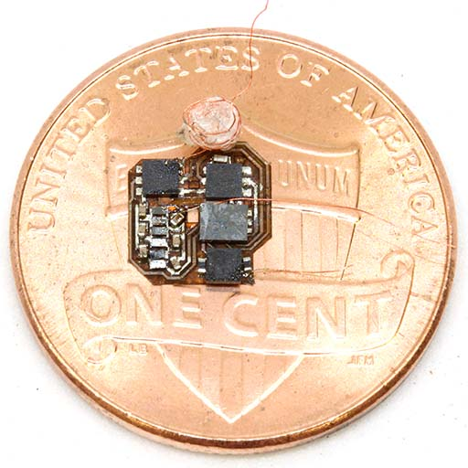
Programmable general purpose design
Programmable microcontroller
Interfaces with temperature and humidity sensors
Low range backscatter communication
Weighs < 30 mg

Slide 15
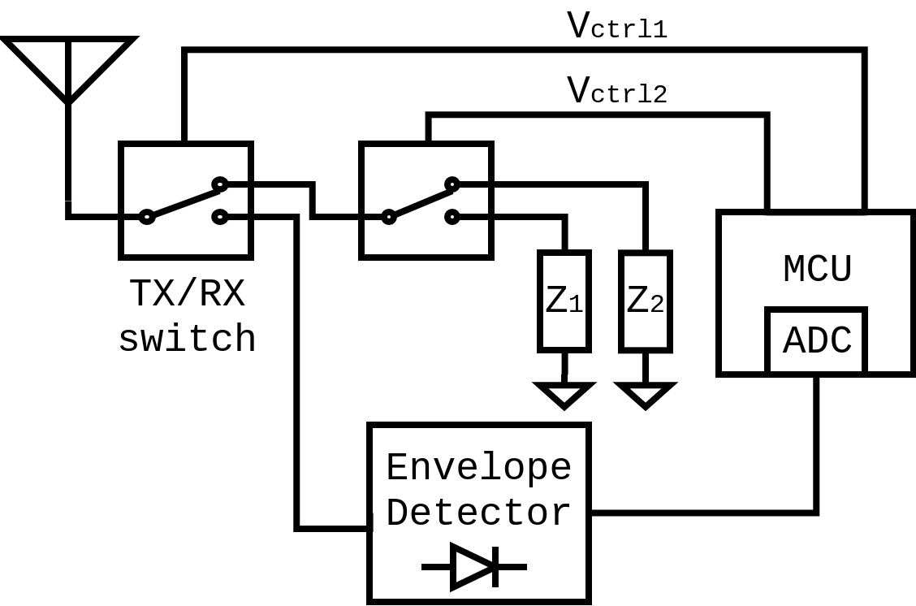
Programmable general purpose design
Backscatter TX
Receiver

Slide 16
How do we fabricate it?
Step 1: Etch traces with laser
Step 2: Apply solder and place
components
Step 3: Solder components on hot plate

Slide 17
Our Solutions
Building lightweight hardware
2D location tracking of bees

Slide 18
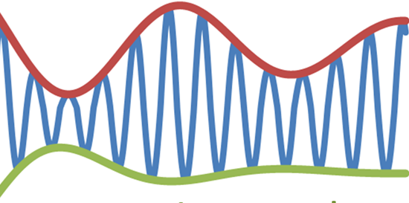
Self localization
Problem: GPS is power expensive
Solution: Passive receiver circuit
GPS

Slide 19
How can we get phase and compute 2D location with just amplitude?

Slide 20
Extracting phase from amplitude
Addressing multipath:
On a farm line of sight path is strongest
Use multiple frequencies to reduce error

Slide 21
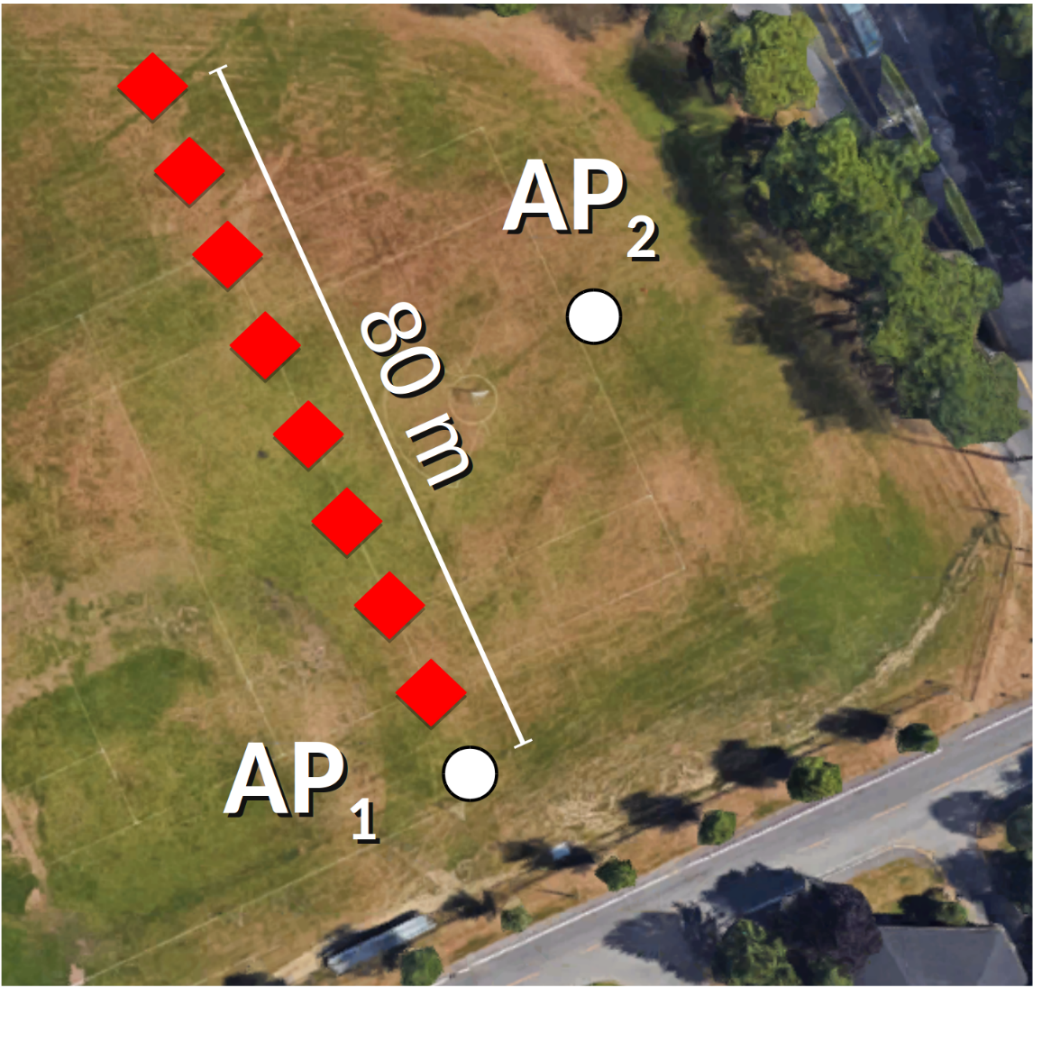
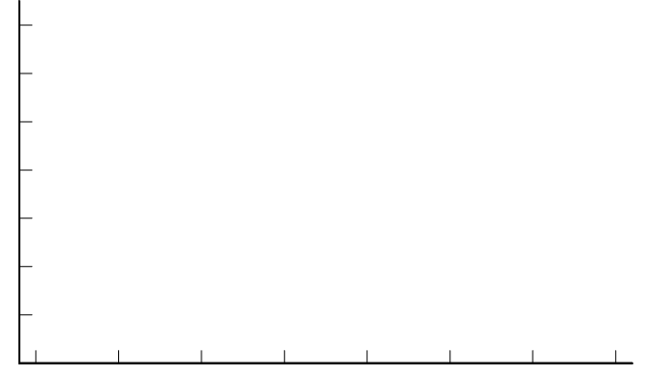
Evaluating localization accuracy
2.25 m/s
3.3 m/s
9.1 m/s
14
12
10
8
6
4
2
0
Angular error (deg)
10 20 30 40 50 60 70 80
Range (m)

Slide 22
Evaluation
System benchmarks
Stores up to 8000 location and humidity sensor data pairs
Battery life of 7 hrs sampling every 4 s
Harvester can recharge battery in a hive in 6 hrs

Slide 23
Contributions
Insects can be used to carry general purpose sensors
Novel low power self-localization technique
Light-weight programmable platform for computing, communication and sensing

Slide 24
What’s next?
What other sensors can we use?
Can we stream sensor data in real time?
Can we use live insects to build bio-hybrid robots?
Can we use these technologies to better study insects?

Slide 25
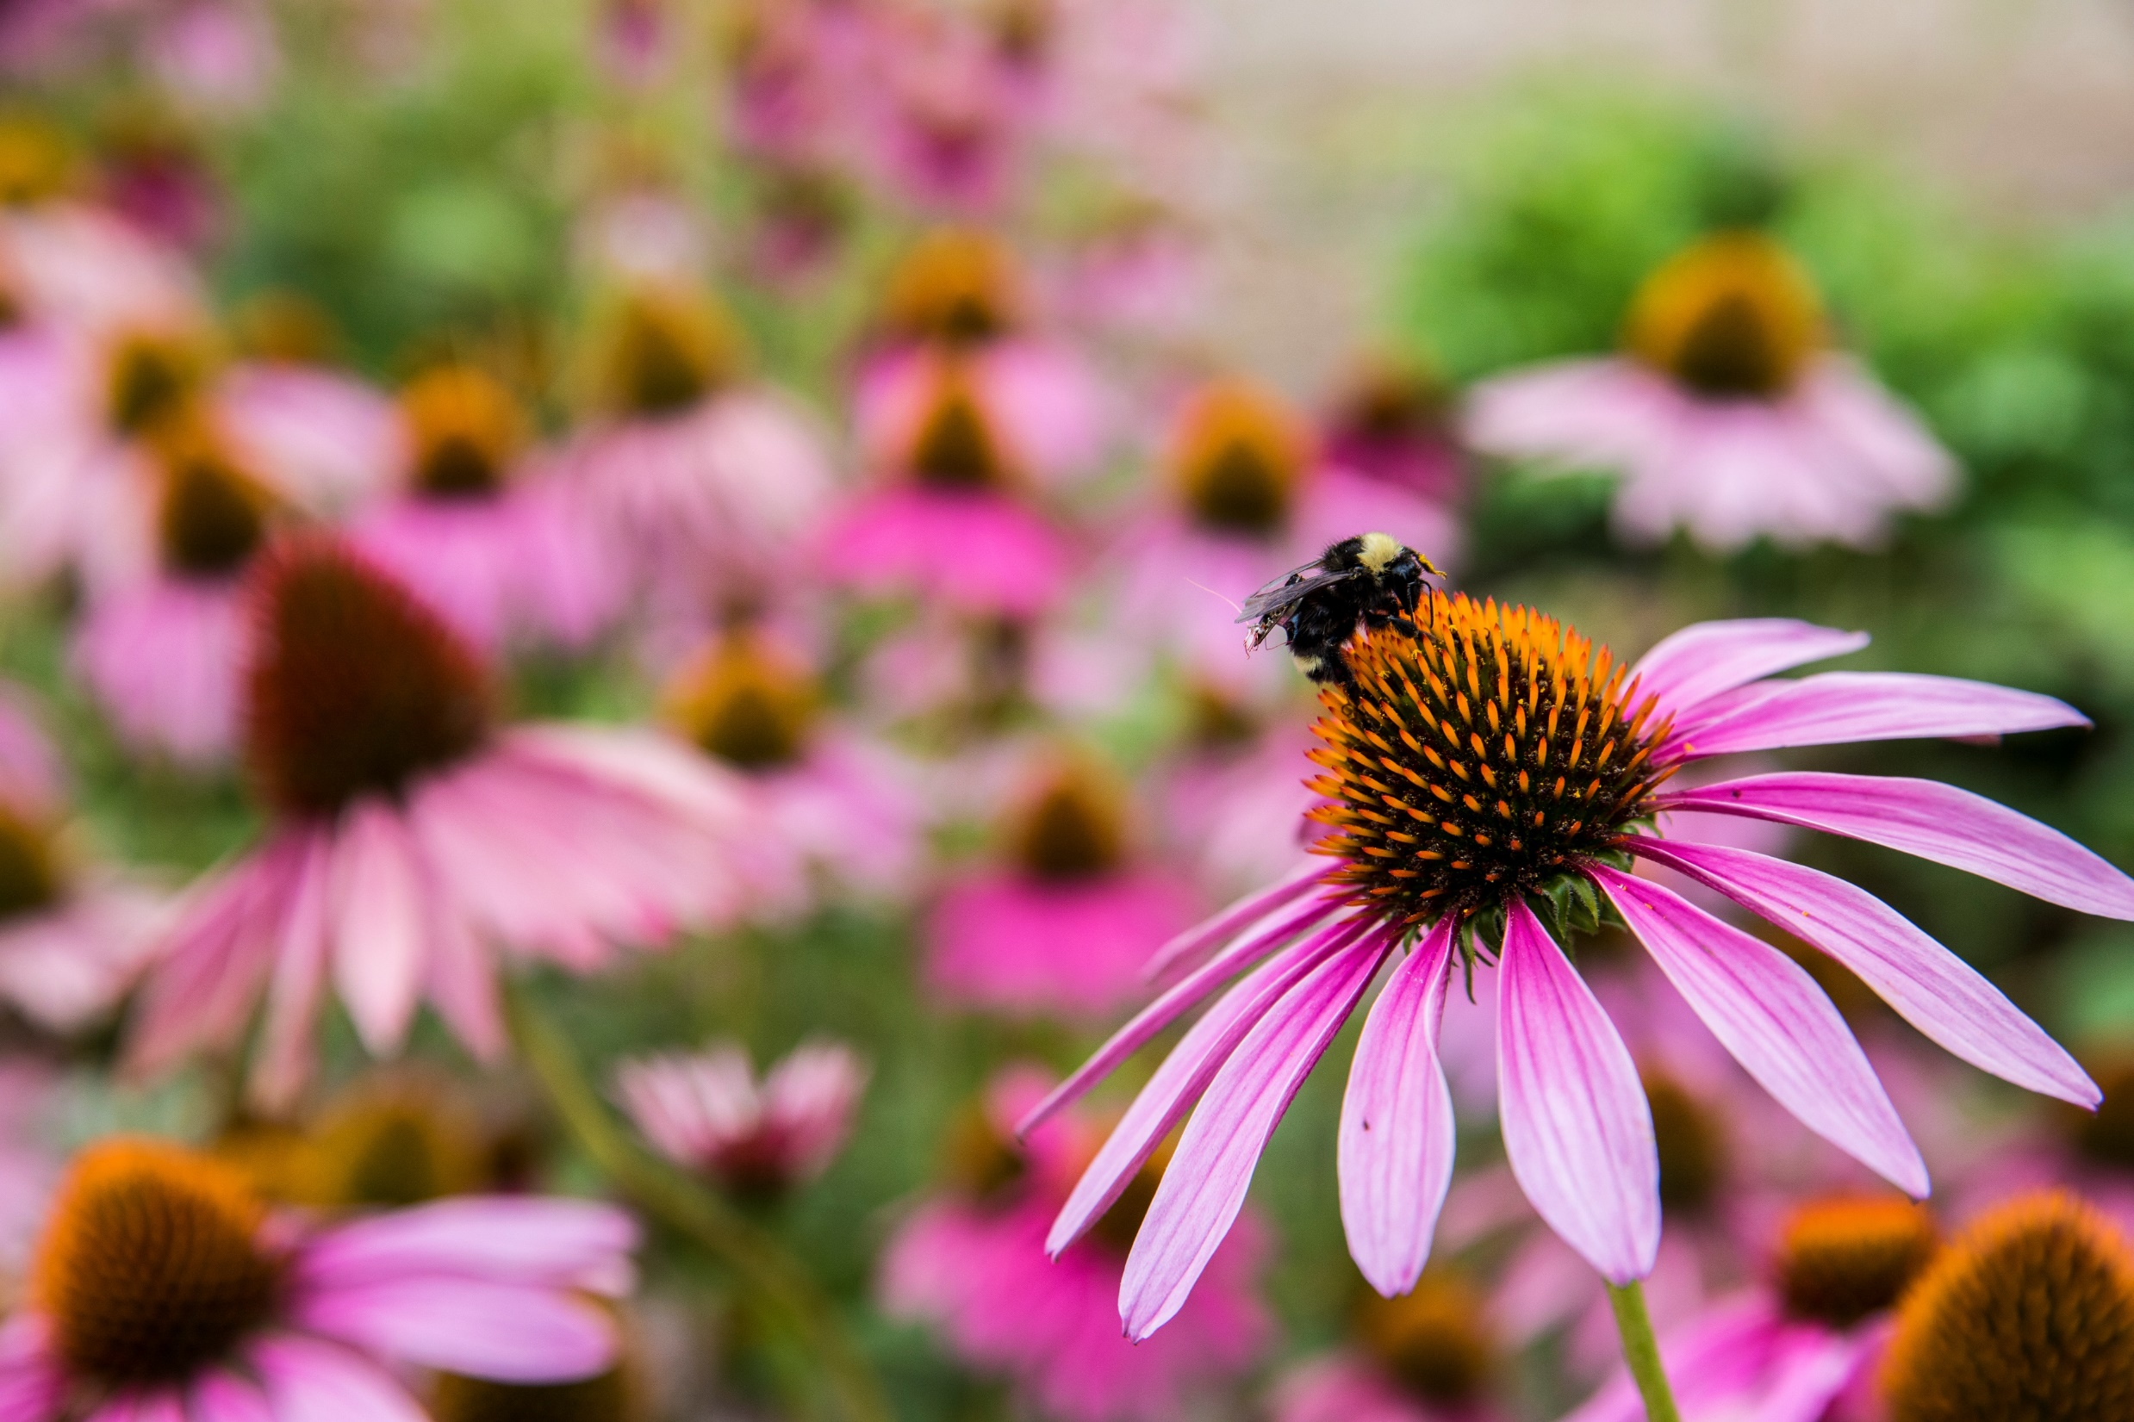
livingiot.cs.washington.edu

